Slide 1
ENSE 470, Milestone 5
Tiger Vikings
Team members:
Samuel Iregbu
Christian Anwanaodung
Jay Denesik
Uys Kriek
March 14th, 2018

Slide 2
Acceptance Test-Driven Development (ATDD) criteria for MVP-Release 1
The pages below show our Acceptance Test-Driven Development (ATDD) criteria for MVP-Release 1
We came up with 11 of them following our user stories for MVP release 1.
The following slides explain our ATDD criteria in detail.

Slide 3
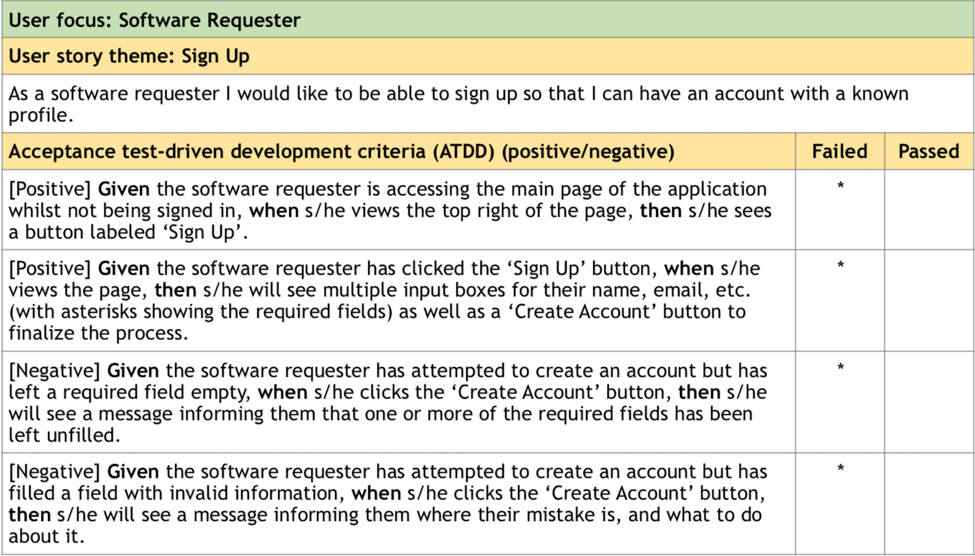

Slide 4
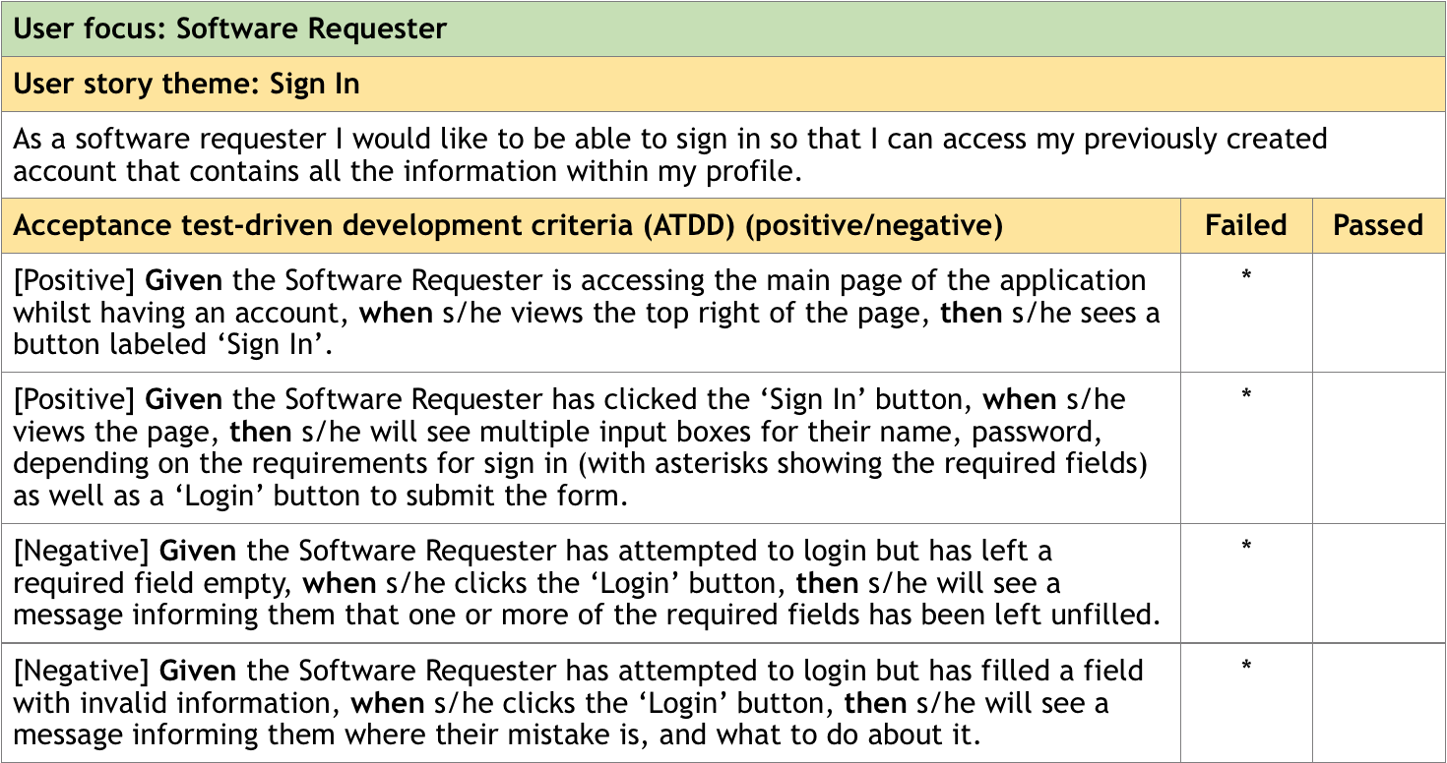

Slide 5
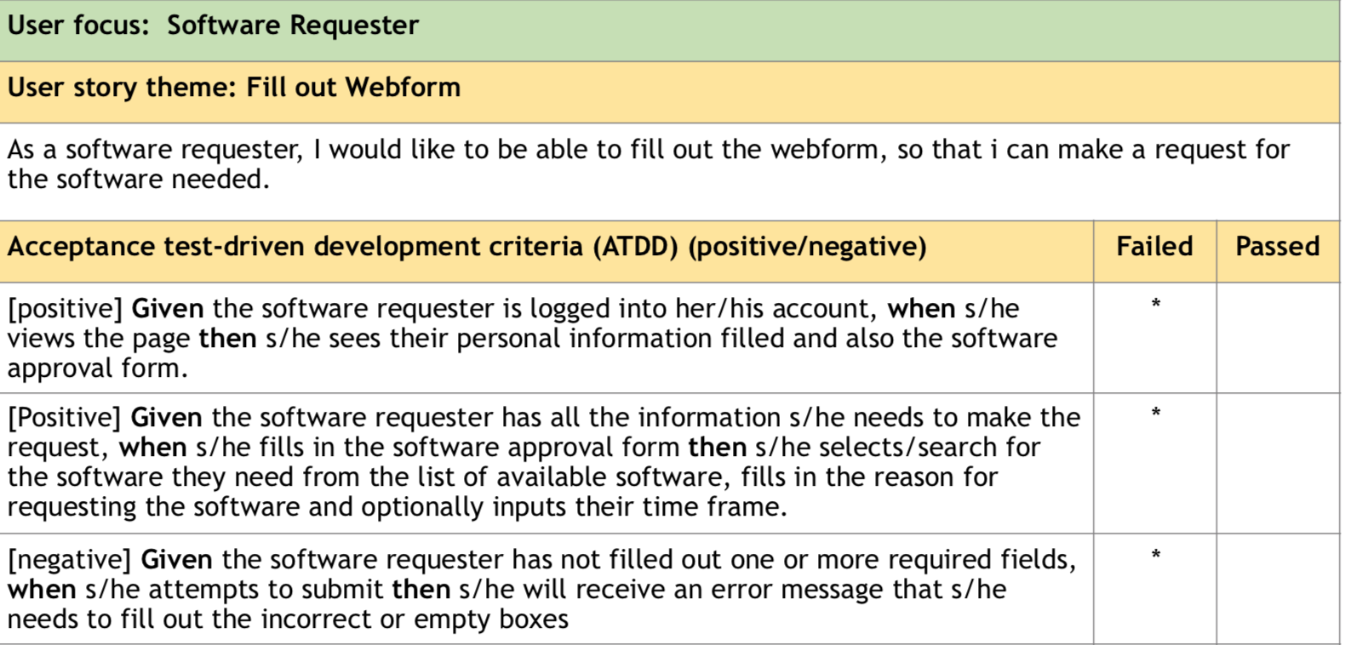

Slide 6
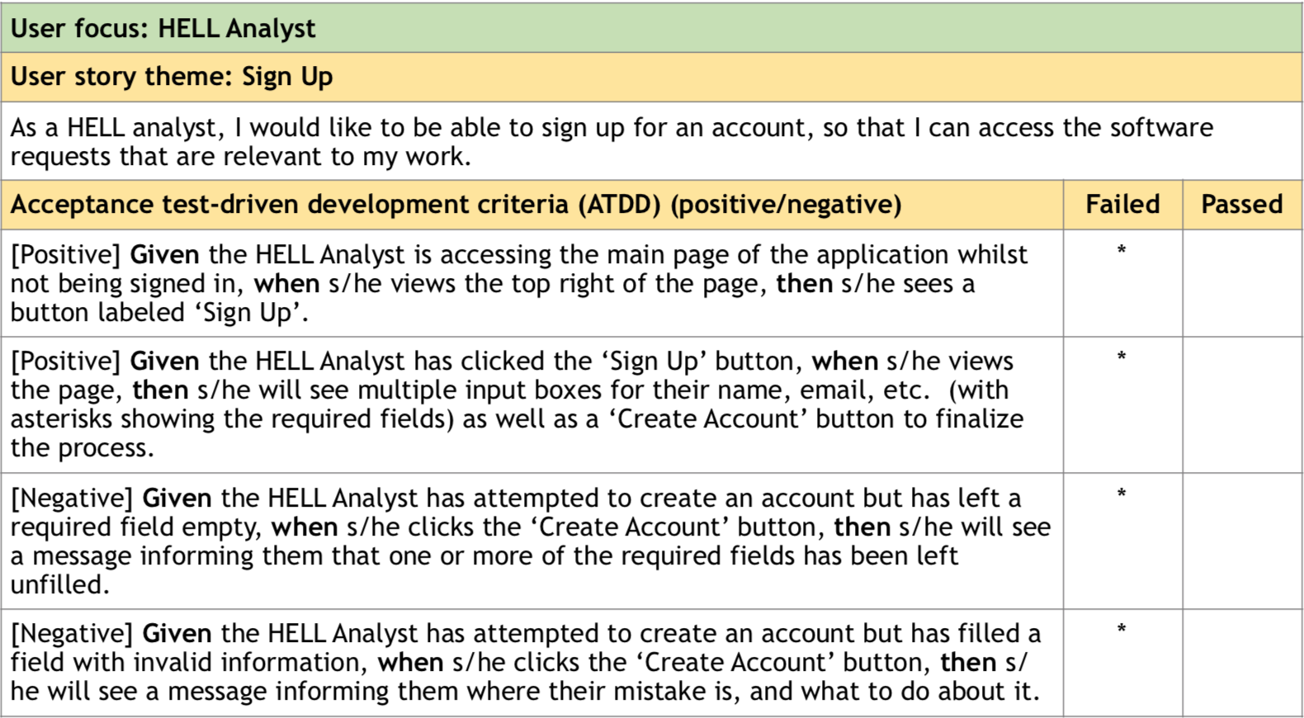

Slide 7
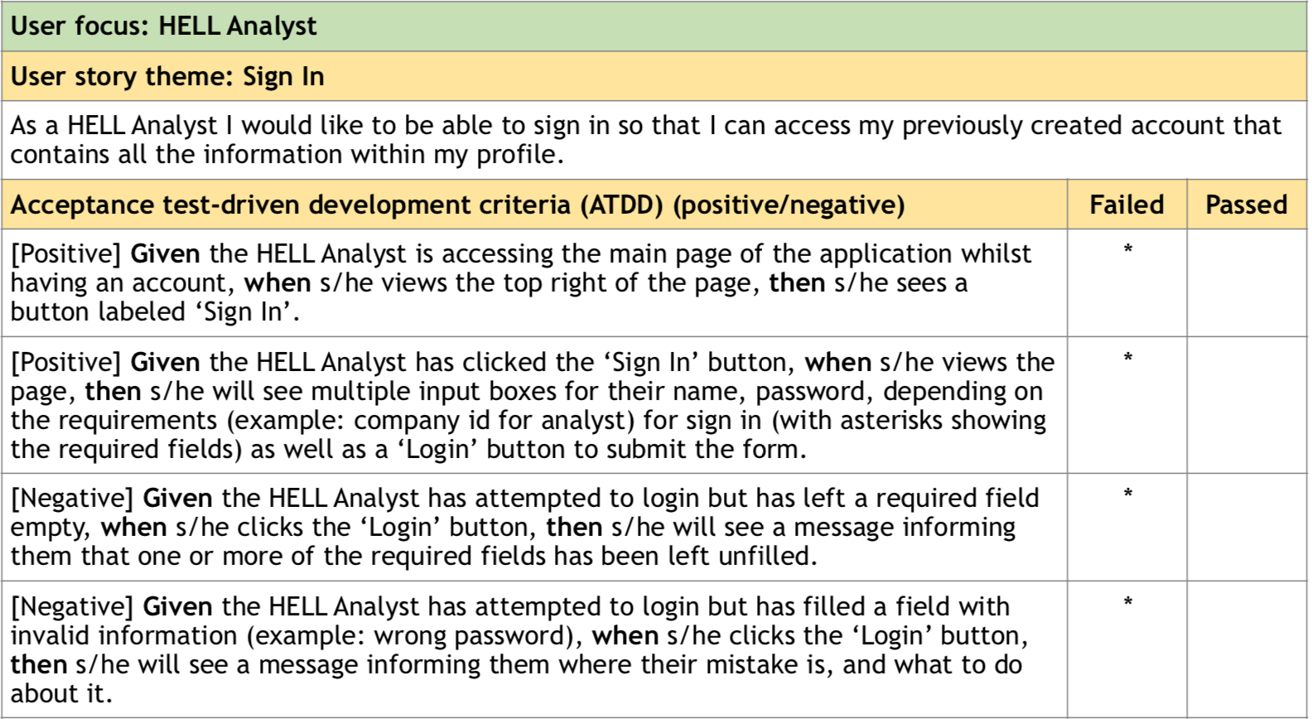

Slide 8
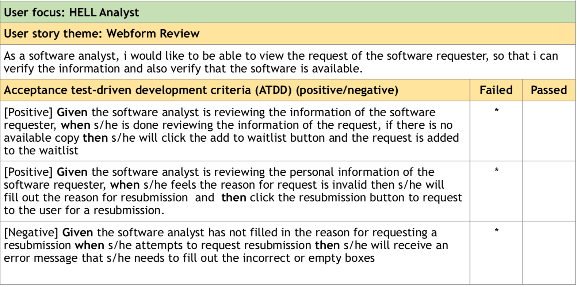

Slide 9
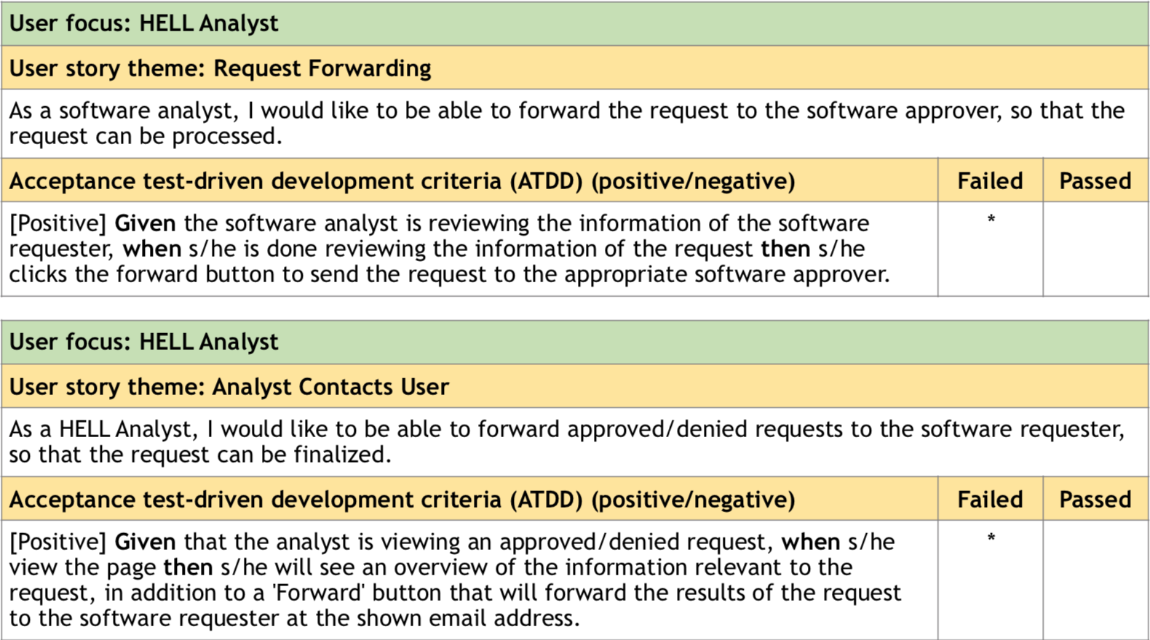

Slide 10
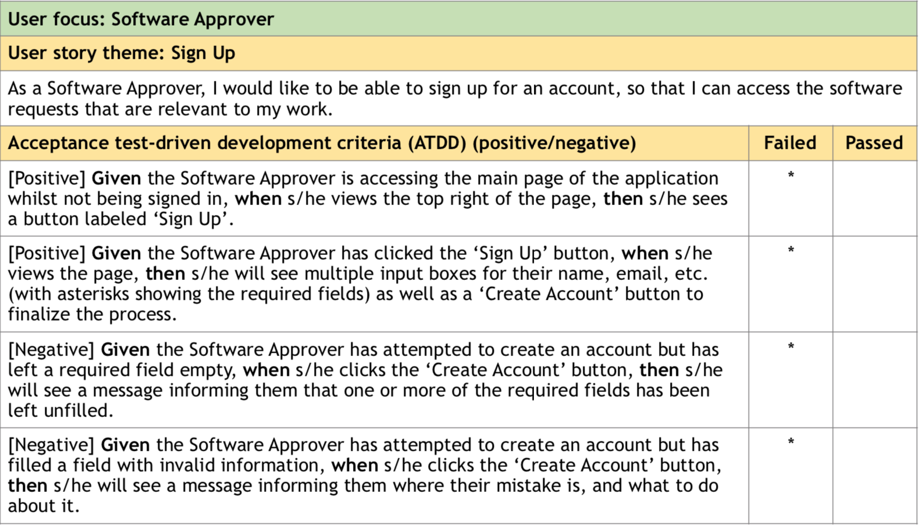

Slide 11
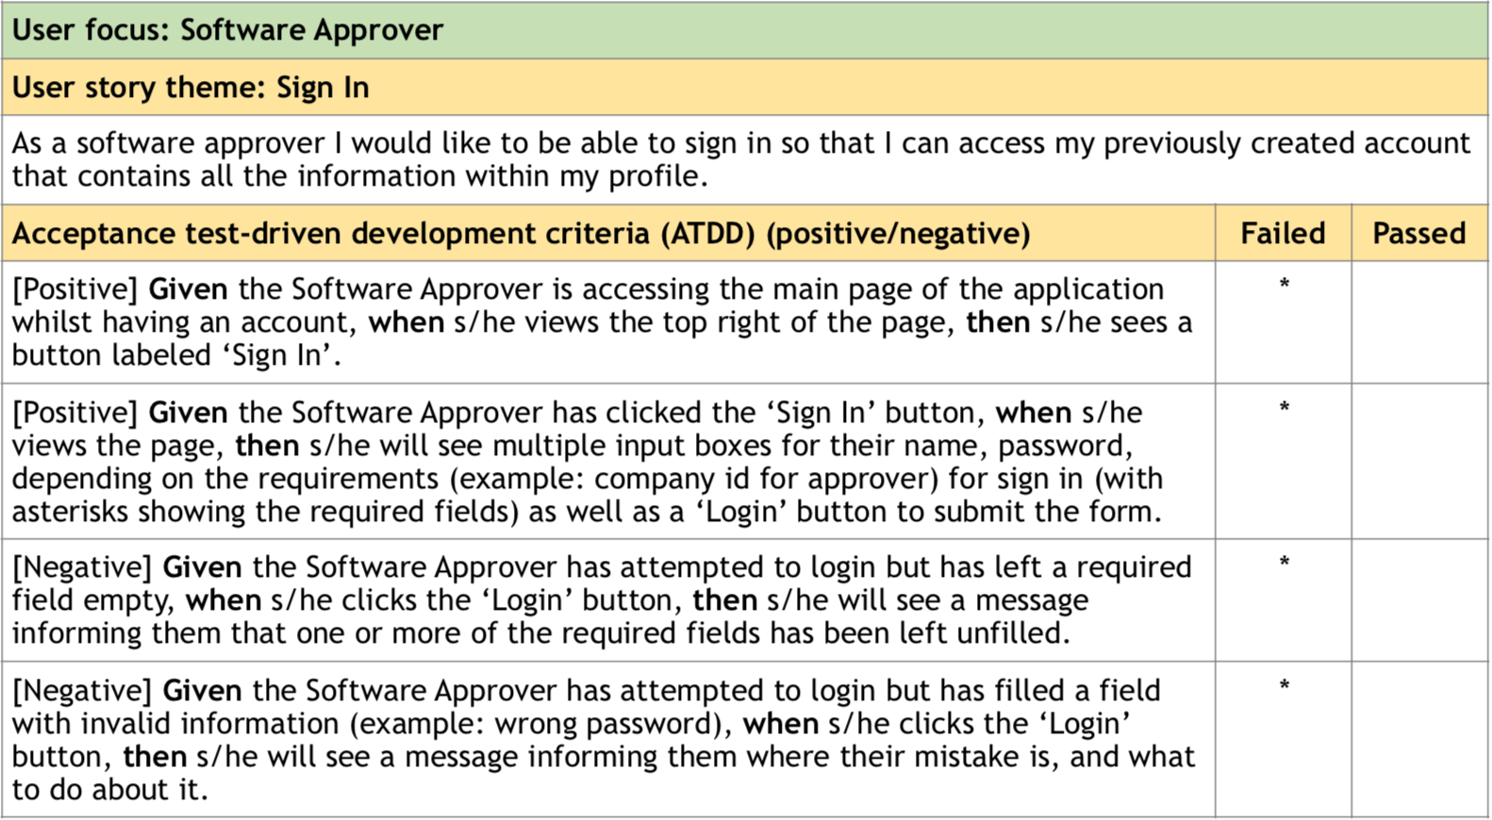

Slide 12
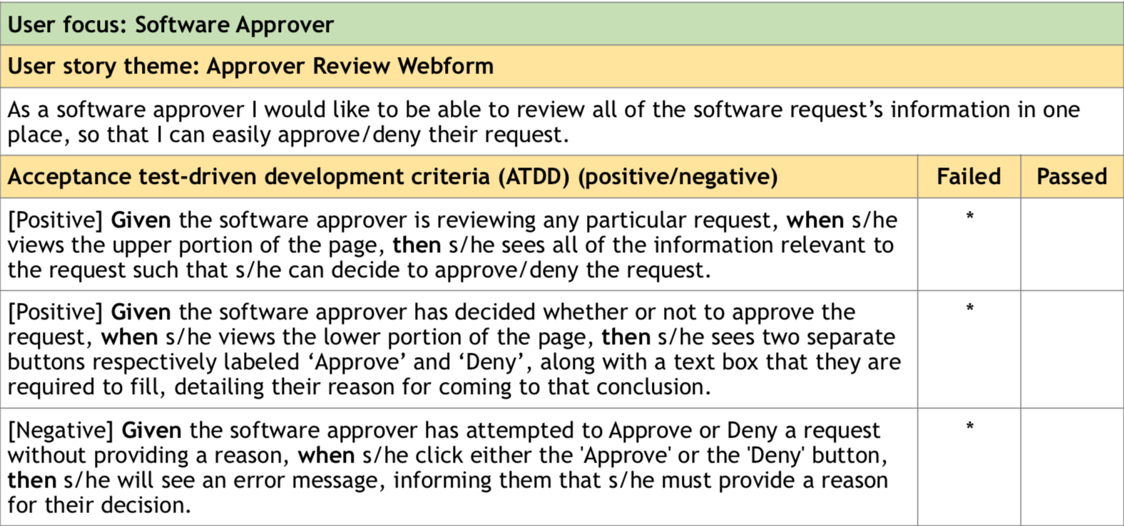

Slide 13
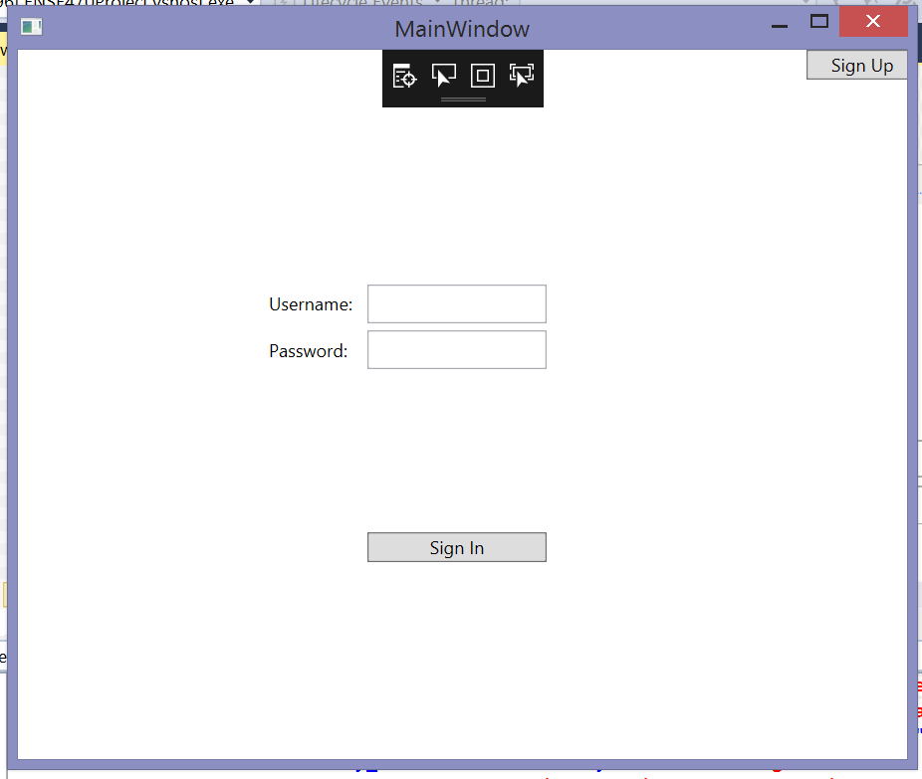

Slide 14
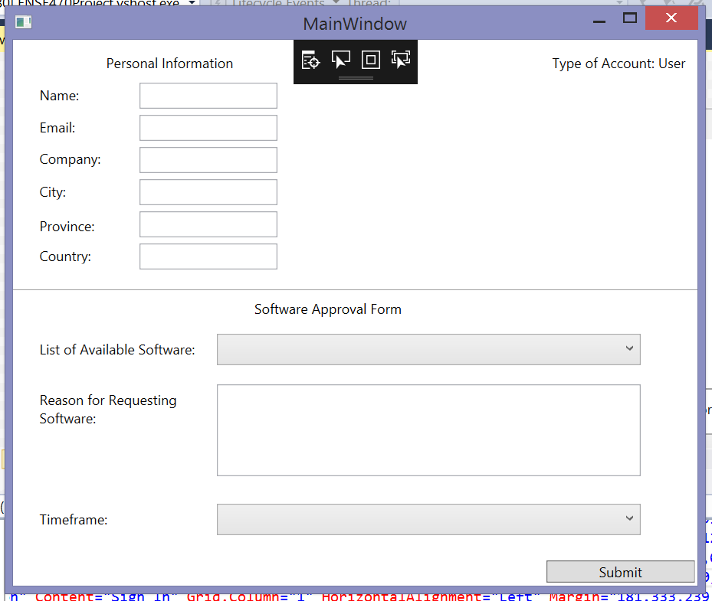

Slide 15
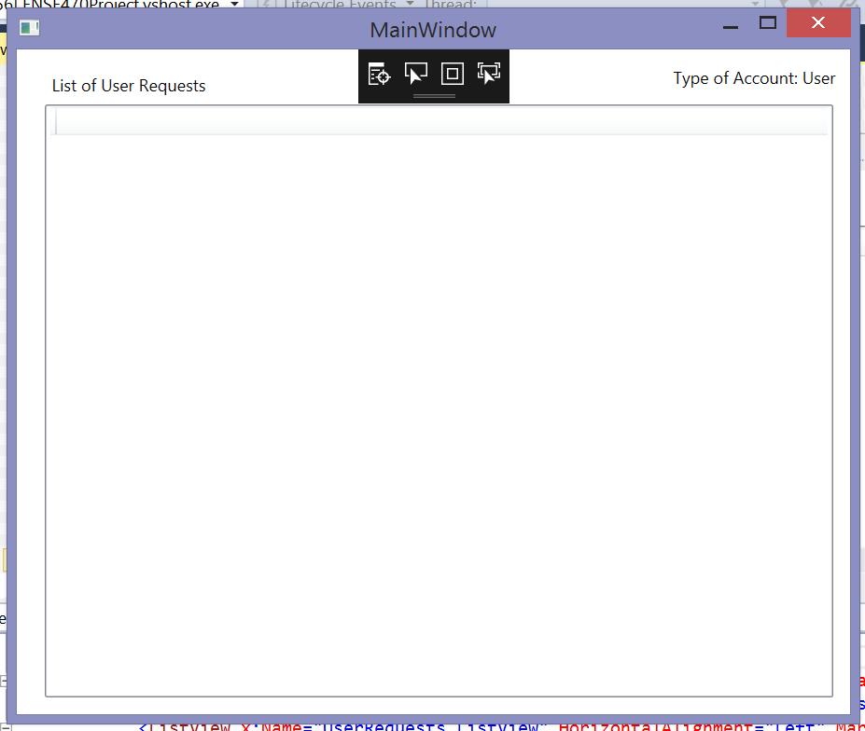

Slide 16
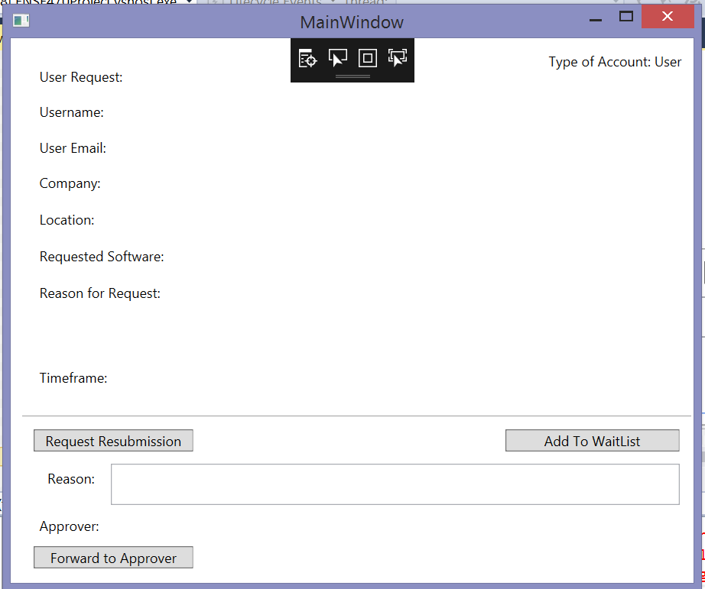

Slide 17
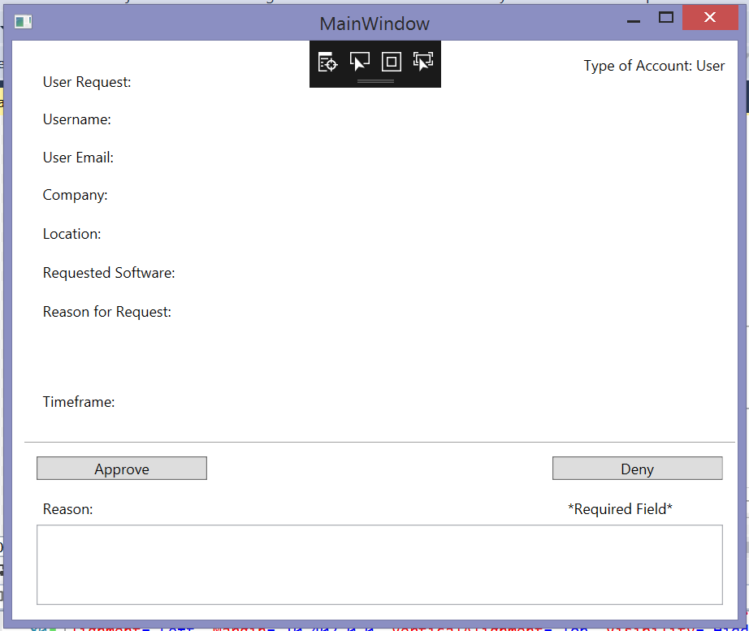

Slide 18
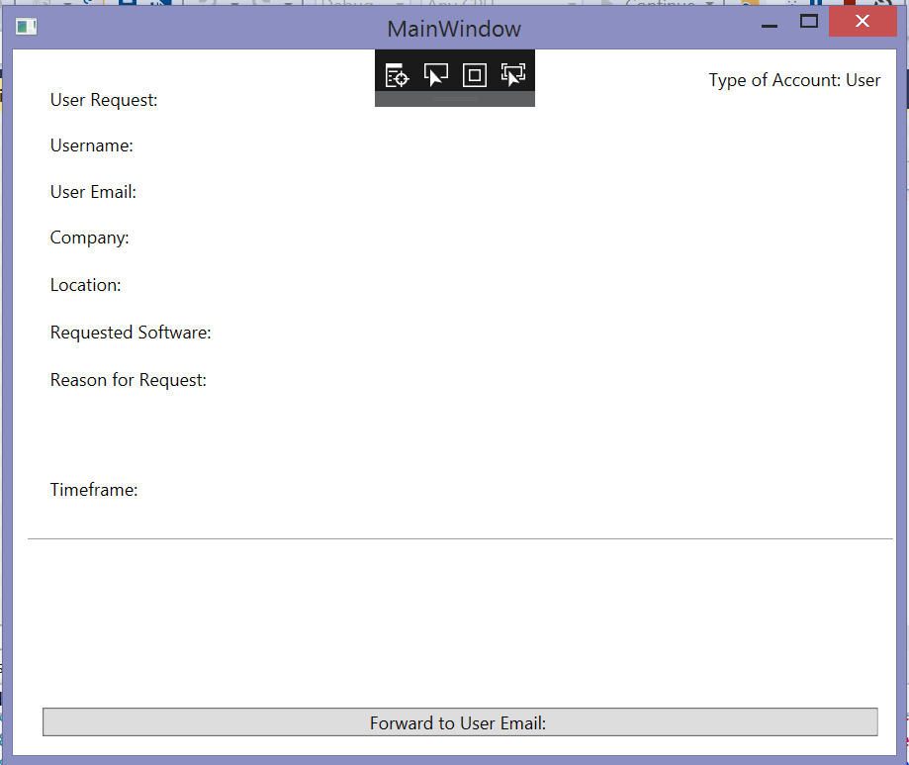

Slide 19
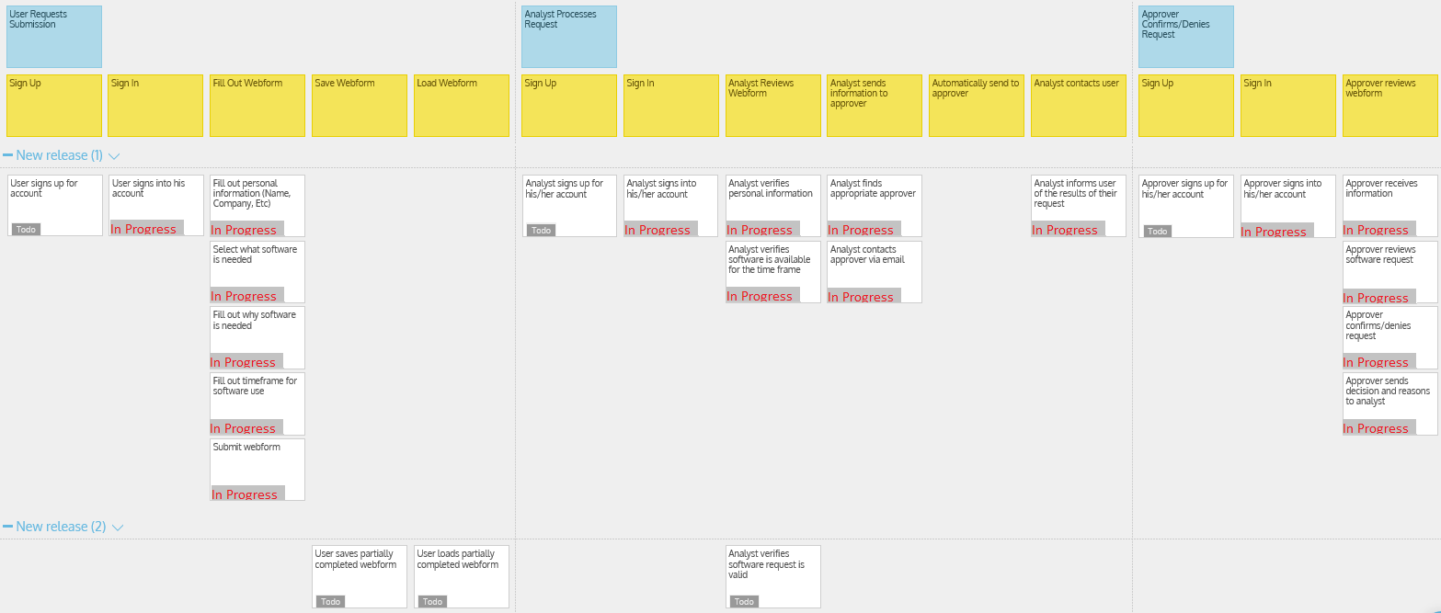

Slide 20
Group Reflection
How did you feel about this milestone? What did you like about it? What did you dislike?
It got us thinking about the project more and evaluating things that can be change and things should stay the same.
What did you learn about yourself as you collaborated and worked through this milestone?
We learned how to work more efficiently while splitting the work amongst ourselves.
How will you use what you have learned going forward?
It helped us thinking ahead for the coding.
What “stuff & things” related to this milestone would you want help with?
Nothing in particular.

Slide 21


